Slide 1


Weekly Report NTUA 13/12/2019
George Bakas

Slide 2
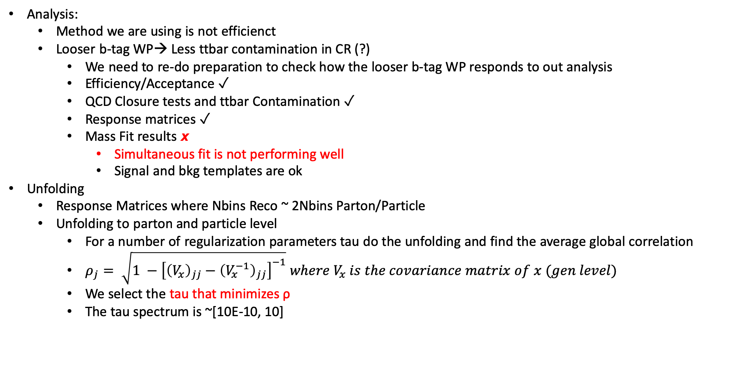
Status Report
Analysis:
Method we are using is not efficienct
Looser b-tag WP→ Less ttbar contamination in CR (?)
We need to re-do preparation to check how the looser b-tag WP responds to out analysis
Efficiency/Acceptance ✓
QCD Closure tests and ttbar Contamination ✓
Response matrices ✓
Mass Fit results 𝙭
Simultaneous fit is not performing well
Signal and bkg templates are ok
Unfolding
Response Matrices where Nbins Reco ~ 2Nbins Parton/Particle
Unfolding to parton and particle level
For a number of regularization parameters tau do the unfolding and find the average global correlation
$ρ_{j}= \sqrt{1 −{\left[{\left(V_{x}\right)}_{jj}−{\left(V_{x}^{−1}\right)}_{jj}\right]}^{−1}} where V_{x} is the covariance matrix of x (gen level)$
We select the tau that minimizes ρ
The tau spectrum is ~[10E-10, 10]

Slide 3
Signal Extraction
Measured dist from data
QCD shape taken from Data (CR)
$$S\left(x_{reco}\right)=D\left(x_{reco}\right)−N_{QCD, reduced}^{(2)}C_{QCD}^{shape}\left(x_{reco}\right)Q\left(x_{reco}\right)−B(x_{reco})$$
Fiducial Yield
ABCD Method
QCD shape correction factor
Subdominant bkg shape and contribution (MC)
Where x_{reco} is the respected variable of interest (ttbar mass,pt, rapidity, leading and subleading jetPt and |jetY|)
We deploy a simultaneous fit in 3 regions (0,1,2 btag) because we do not have a pure Control Region.
Our data CR is ttbar contaminated
$$D{\left(m^{t}\right)}^{(i)}=N_{tt}^{(i)}T^{(i)}\left(m^{t},k_{MassScale}, k_{MassResolution}\right)+N_{bkg}^{(i)}B\left(m^{t} \right)\left(1+k_{1}x\right)+N_{sub}^{(i)}O^{(i)}\left(m^{t}\right)$$
We assume that $N_{tt}^{(0)}={\left(1−e_{b}\right)}^{2}N_{tt}, N_{tt}^{(2)}=e_{b}^{2}N_{tt} and N_{tt}^{(1)}=2\left(1−e_{b}\right)e_{b}N_{tt}$ where e_{b} is the b tagging efficiency and N_{tt} is the total ttbar yield.

Slide 4
Fiducial Measurements (jetPt0) ABCD method and free eb
2016
2017
2018
Output is not consistent with what we expected
We expect r ~ 0.85 for 2016, ~0.65 for 2017 and ~0.75 for 2018
After signal extraction r ~ 0.96 for 2016, ~0.63 for 2017 and ~0.89 for 2018
Nqcd in SR reduced probably the problem (not enough QCD extracted?)

Slide 5
Fiducial Measurements (mJJ) ABCD method and free eb
2016
2017
2018

Slide 6
Fiducial Measurements for all years combined

